Slide 1
Künstliche Intelligenz und Cultural Heritage: Upper Brandberg – Im Louvre der Felsmalerei
Dr. Jan Gerrit Wieners
Prof. Dr. Øyvind Eide

Slide 2
The use of Computer Vision for the binary classification of humans and animals
Group 5
Code: https://github.com/LauraHossdorf/kuenstliche-Intelligenz

Slide 3
Why Matlab ?
Simple programming language
GUI (Visualization of the results)
Documentation (offers help and you can find many tutorials on the Internet)
has integrated Computer Vision and Neural Network tool

Slide 4
Workflow
Object detection in every picture
Sorting the images in the correct folder
Creation of a neural network
Image processing and scaling
Classification

Slide 5
Object detection, image processing & image scaling
Convert colored image to black and white
Object detection in the image
Image scaling
Save the scaled image
Notes:
( mit bestimmten Größe)

Slide 6
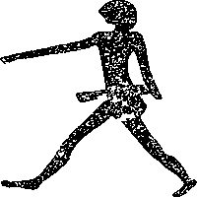

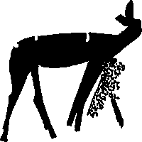
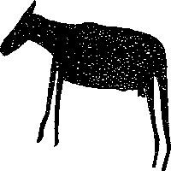
Image scaling results

Slide 7
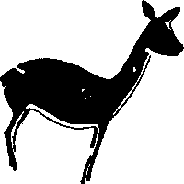

Classification results
The project is successful
fast
90% accordance

Slide 8
Improving the success rate
Better image processing.
Improving our neural network or using an existing one.
Provide more images for the training of the neural network.

